Slide 1

BOOK SCRAPER
Presented by
Saurav Roy
Intern Software Engineer
W3 Engineers Limited
Date: January 3, 2024

Slide 2

OUTLINES
Introduction
Scrapy Life Cycle
Implementation
Results
Conclusion
2

Slide 3
INTRODUCTION
Book Scraper is an application developed using the Scrapy technology.
Target website: https://books.toscrape.com/ .
Information scraped:
Product Titles
Prices
Ratings
Store data in a csv file.
3

Slide 4
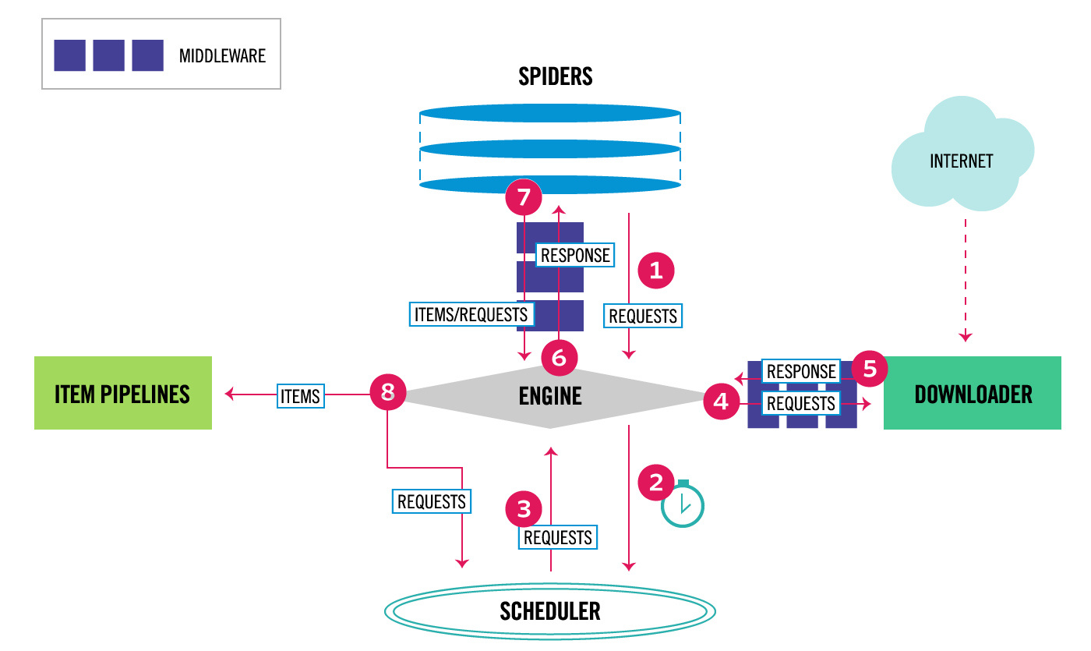
SCRAPY LIFE CYCLE
4
Figure 1: Scrapy Life Cycle

Slide 5
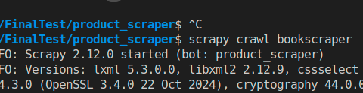
IMPLEMENTATION
Step 1: Initial Requests to crawl from the Spider.
Figure 2: Crawl request from spider
5

Slide 6
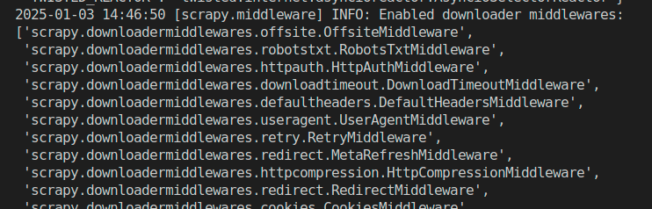
IMPLEMENTATION (CONT.)
Step 2: Enable downloader middlewares. The engine sends a download request to the downloader. The downloader generates a response.
Both pass through the middlewares for processing.
6
Figure 3: Downloader middlewares

Slide 7
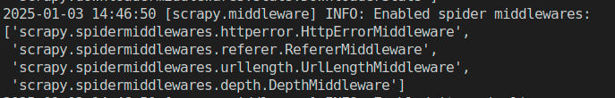
IMPLEMENTATION (CONT.)
Step 3: Enable spider middlewares.
The Engine receives the Response from the Downloader and sends it to the Spider.
The Spider processes the Response and returns scraped items and new Requests (to follow).
Figure 4: Spider middlewares
7

Slide 8
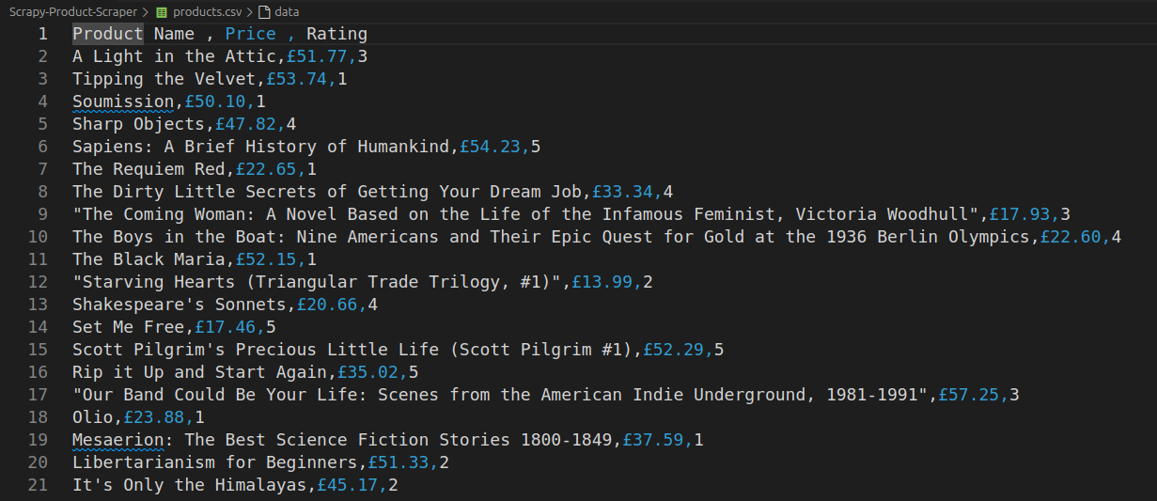
IMPLEMENTATION (CONT.)
Step 4: Save the data to CSV.
Figure 5: Output CSV file
8

Slide 9
IMPLEMENTATION (CONT.)
Step 5: Send items to Item Pipelines
The Engine sends processed items to Item Pipelines, then send processed Requests to the Scheduler and asks for possible next Requests to crawl.
Since no database is used for this project, the items pipeline is empty.
9

Slide 10
IMPLEMENTATION (CONT.)
For scraping, these three elements are used in this project:
For Title: a::attr(title)
For Price: p.price_color::text
For Rating: p::attr(class)
10

Slide 11
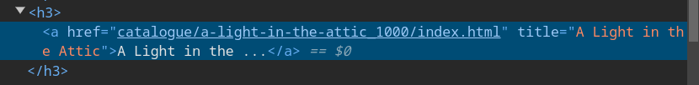

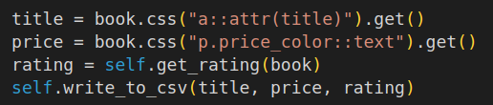
IMPLEMENTATION (CONT.)
Figure 6: Webpage elements
Figure 7: Code to scrape data from response
11

Slide 12
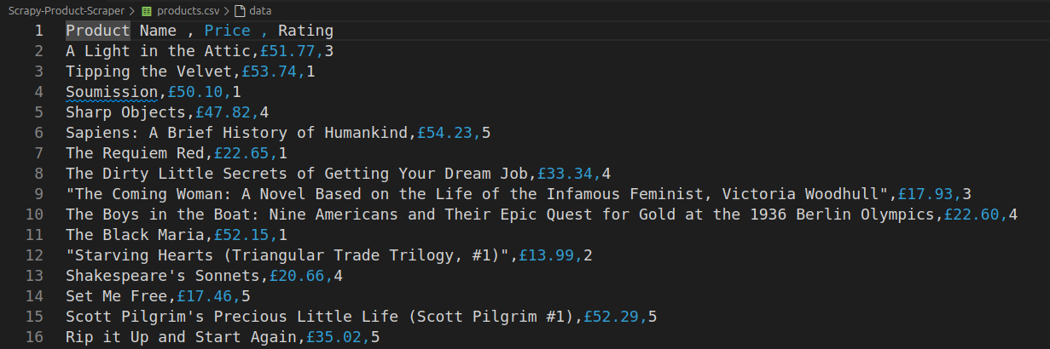
RESULTS
The output is a CSV file which contains the titles, prices and ratings of the books in a webpage.
Figure 8: Output CSV file
12

Slide 13
CONCLUSION
This is a simple project that scrapes data and stores it in a CSV file.
In future, the project can be updated by integrating database.
Middlewares can be added for different cases.
13

Slide 14
THANK YOU

